Slide 1
Foundations of Large Language Models: Tools, Techniques, and Applications
Notes:
Note for instructor: please ensure you check the accessibility of your own slides before you deliver your presentation: https://uwaterloo.ca/centre-for-teaching-excellence/accessibility-checklist-ms-powerpoint

Slide 2

Foundations of Large Language Models: Tools, Techniques, and Applications
(3rd edition)
Instructor: Brian Zimmerman
(based on slides from Rodrigo Nogueira)
Photo source: Bing Image Creator

Slide 3
Overview of Today – Module 1
Lab 1 and 2 Solutions
Review: Prompt Engineering
Retrieval-Augmented LLMs
Encoders vs. Decoders
Bi-Encoders vs. Cross-Encoders
Processing Long Documents
Final Project

Slide 4
Lab 1 and 2 Solutions
[Lab 1]
[Lab 2]

Slide 5
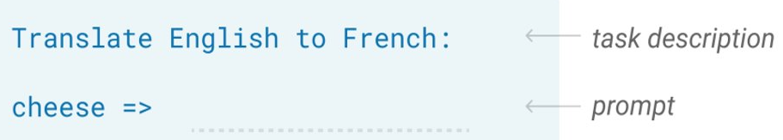
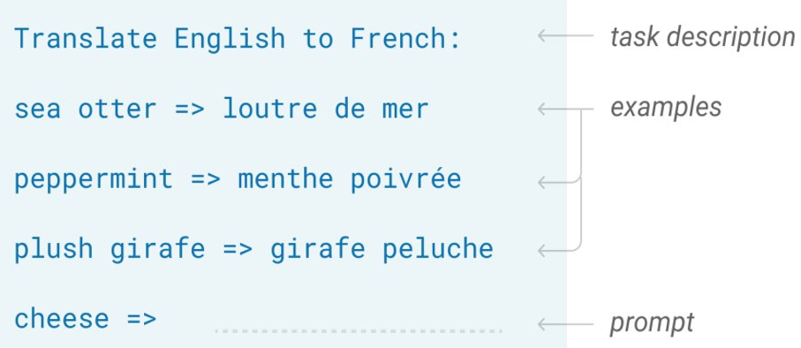
Prompt Engineering
Zero Shot
The model predicts the answer given only a natural language description of the task.
Few Shot
In addition to a task description, the model sees a few examples of the task.

Slide 6
Prompt Engineering
Benefits of Few Shot Prompting
Easily define an output format
Better results than zero shot
Caveats
Requires several annotated examples
Requires more context space
[Best Practices for Prompt Engineering]

Slide 7
Prompt Engineering – Chain of Thought
Motivating a language model to explain itself through intermediate steps is called “Chain of Thought” prompting.
Input
Q: Roger has 5 tennis balls. He buys 2 more cans of tennis balls. Each can has 3 tennis balls. How many tennis balls does he have now?
A: Roger started with 5 balls. 2 cans of 3 tennis balls each is 6 tennis balls. 5 + 6 = 11. The answer is 11.
Q: The cafeteria had 23 apples. If they used 20 to make lunch and bought 6 more, how many apples do they have?
[Link to Paper]
One shot example of an explanation
Model Output
A: The cafeteria had 23 apples originally. They used 20 to make lunch. So they had 23 - 20 = 3. They bought 6 more apples, so they have 3 + 6 = 9. The answer is 9.
Common mistake: Asking for the answer before the explanation. Why?

Slide 8
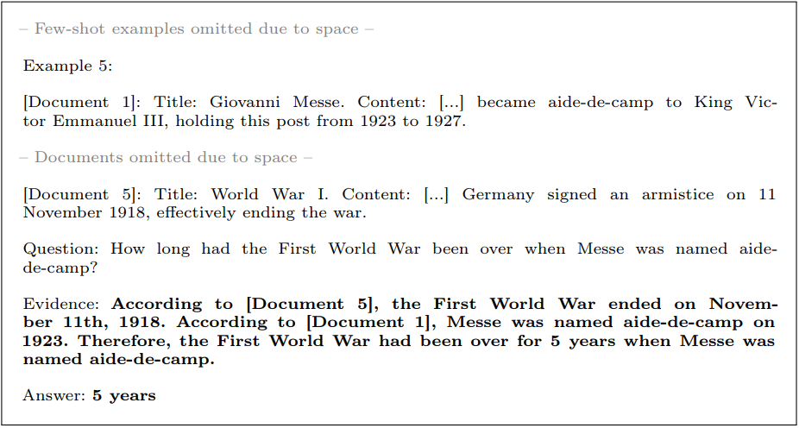
Prompt Engineering – Multidocument Question Answering
OpenAI playground prompt
Source: Visconde

Slide 9
But how do we select the best documents?
Selected by humans
Selecting documents manually for each query is impossible
Next best thing: Use a search engine!
q
d₁
d₂
d₃
GPT-3.5
a
q
IIRC dataset | F1
Human | 88.4
GPT-3.5 + "Oracle" documents | 84.2
GPT-3.5 + SOTA search engine | 47.9
Search engine
q
d₁
d₂
d₃
GPT-3.5
Source
a

Slide 10
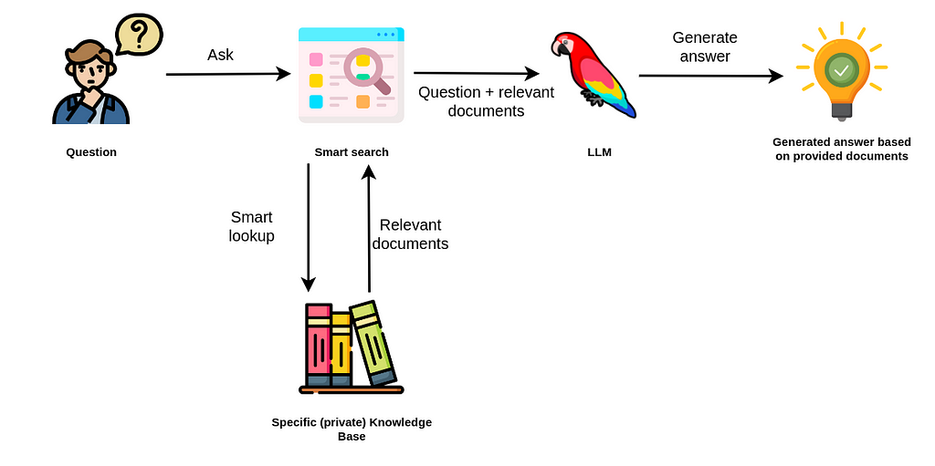
A simple Retrieval Augmented Generation (RAG) pipeline
question
question +
retrieved documents
User
search engine
question
retrieved documents
Collections of (private) documents
Source

Slide 11
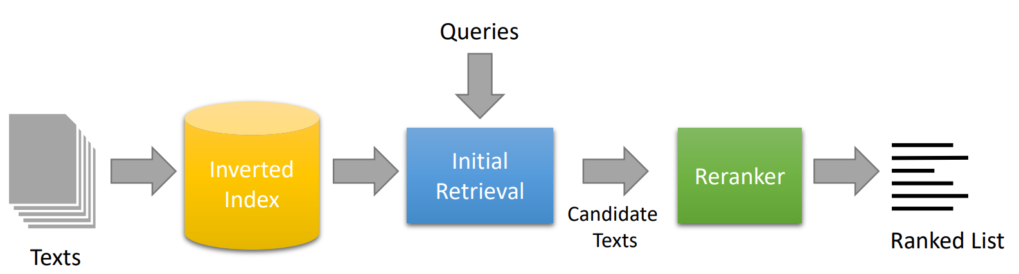
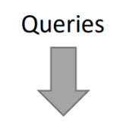
Search Engines – Overview
ANN
Index

Slide 12
Search Engines – Overview
Dense retrievers
ANN
Index

Slide 13
Dense retrievers and what they solve
Goal: Solve the vocabulary mismatch problems by using vector representations of texts.
Continuous dense vectors ℝ^{D}
q = "large screen tv"
Encoder
0.8 | -1.2 | ... | 2.4 | -0.3
𝜂(q)
d = "... 55-in television..."
Encoder
0.5 | 0.0 | ... | 2.6 | -0.7
𝜂(d)
𝜙 represents a similarity function
𝜙(𝜂(q), 𝜂(d)) → should measure how relevant document d is to query q

Slide 14
Brute forcing document similarity
query
documents
𝜙
𝜙
Top k:
m dimensions
𝜙
𝜙
n documents
...
w.r.t 𝜙(𝜂(q), 𝜂(d_{i}))
Time complexity of a single dot product: O(m)
What’s the time complexity against all documents?

Slide 15
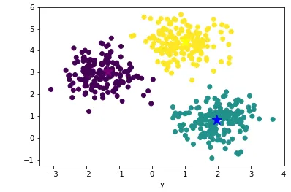
Approximate Nearest Neighbor (ANN) algorithm using k-means
ANN retrieval trades-off quality (relevant docs returned) for speed (query/sec).
Centroids
𝜙 (𝜂(q), 𝜂(d₁))
…
𝜙 (𝜂(q), 𝜂(d_{m}))
𝜙 (𝜂(q), 𝜂(c₁))
𝜙 (𝜂(q), 𝜂(c₂))
𝜙 (𝜂(q), 𝜂(c₃))
query 𝜂(q)
In practice, a fast dense retrieval library such as FAISS should be used. See other algorithms here.

Slide 16
Choosing a retriever
Open-source:
bge-large-en-v1.5 – high performing open-source
multilingual-e5-large – multilingual dense retriever
BM25 – sparse retriever (no GPU required; still high performance)
Proprietary:
OpenAI's text-embeddings-ada-002
Cohere-embed-english-v3.0
You can view more approaches yourself at the HuggingFace MTEB leaderboard and clicking the Retrieval tab.

Slide 17
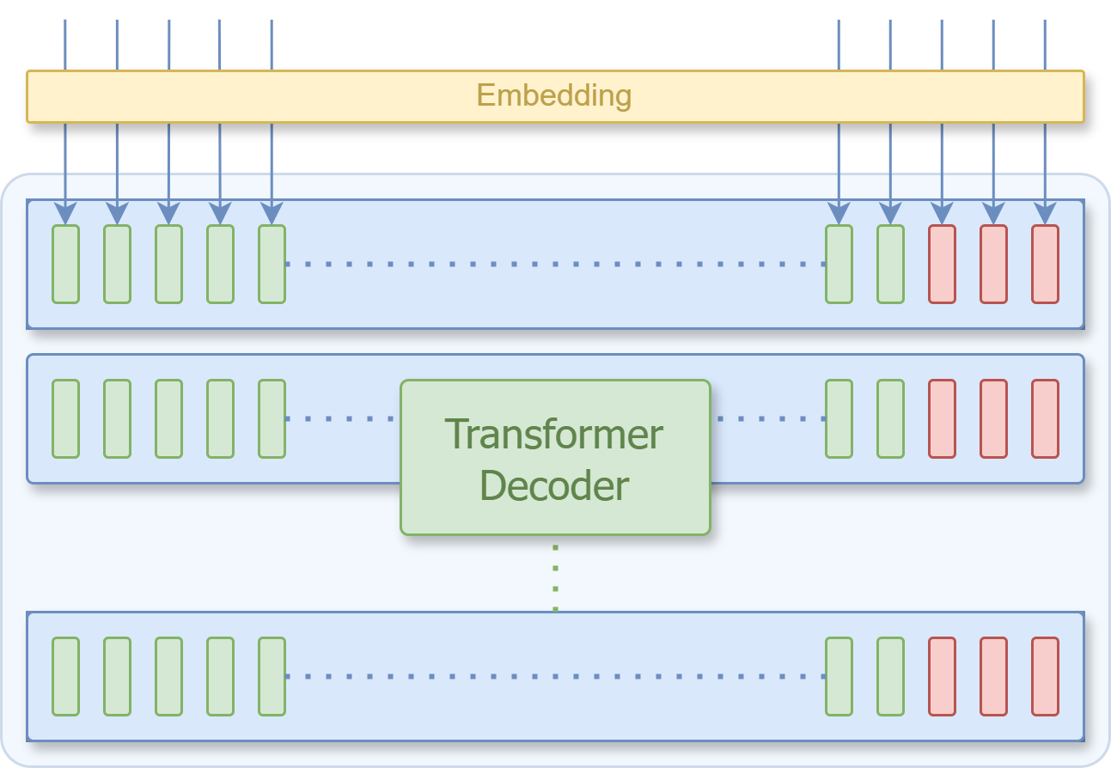
Decoders (Review)
John
went
to
the
store
He
made
fried
rice
.
When predicting the word after “made” we only consider “made” and prior words.
went
to
the
store
.
made
fried

Slide 18
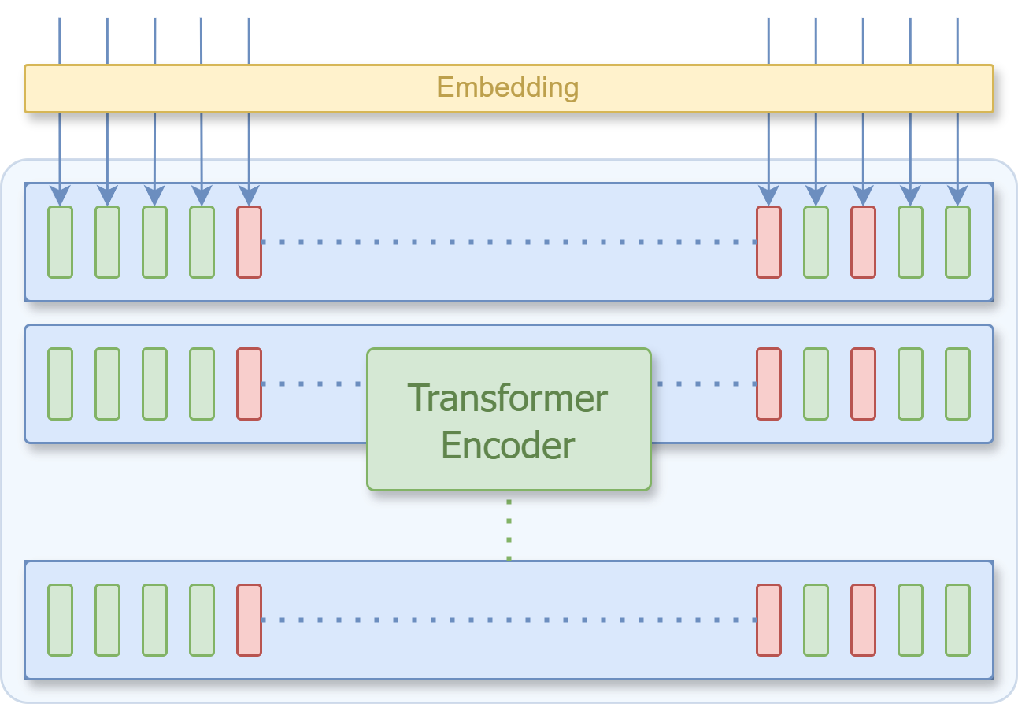
Encoders
John
<MASK>
<MASK>
<MASK>
went
to
the
made
rice
.
What if we attend both ways, but concealing 15% of the words at random?
John
store
went
to
the
He
made

Slide 19
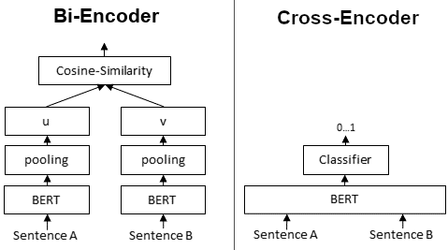
How are encoders used within search pipelines?
Bi-Encoders
Create dense embeddings
Used in retrievers
Cross-Encoders
Jointly encode 2 or more documents
Can rely on attention to compare documents
Used in rerankers
[Image Source]

Slide 20
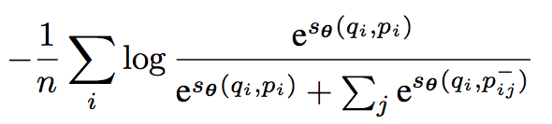
Fine-tuning a Bi-encoder for retrieval
cosine similarity
Loss =
Positive example: query q_{i} + doc p_{i}
Negative example(s): q_{i} + p_{j != i}
q₁
p₁
p₂
p₃
positive docs from other queries (p_{j != i}) serve as negatives for q_{i}
q₂
p₁
p₂
p₃
Sentence Transformers documentation for Contrastive Loss
q₃
p₁
p₂
p₃

Slide 21
Search Engines – Overview
How do cross-encoders compare documents?
Rerankers (cross-encoders)
ANN
Index

Slide 22
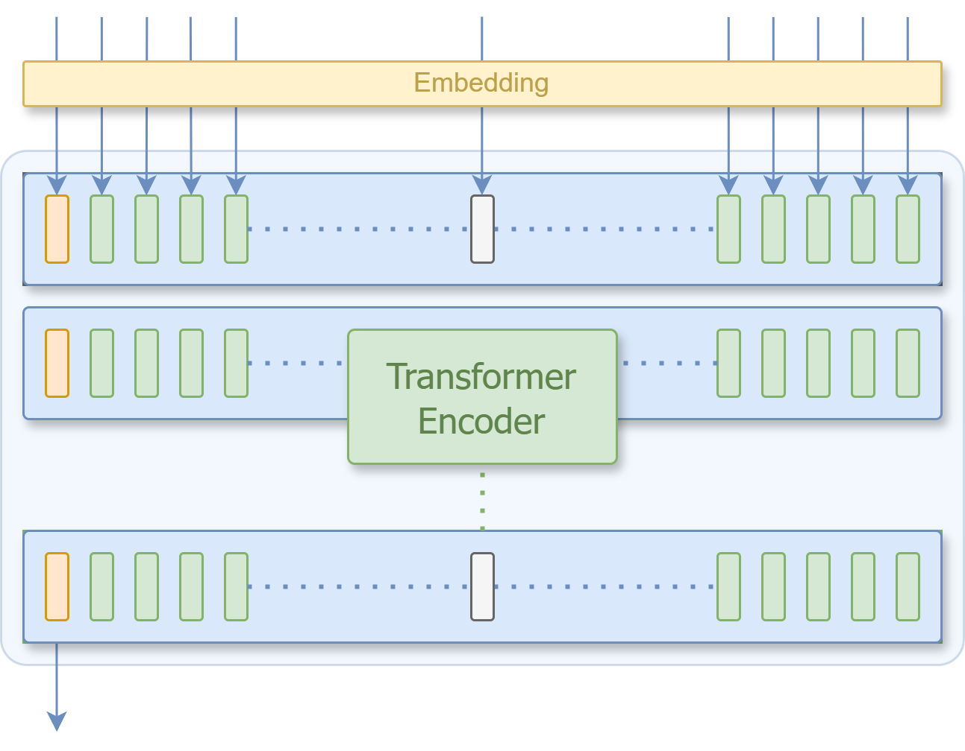
Cross-Encoders
[CLS]
w₀
w₁
w₂
w₃
[SEP]
w_{n-4}
W_{n-3}
w_{n-2}
w_{n-1}
w_{n}
query contents
document contents
Cross-encoders encode multiple documents together.
A joint embedding is produced at the [CLS] position.
But what is it used for?
[CLS]

Slide 23
Cross-Encoders
[CLS]
We can use the output at the [CLS] position as input to a downstream classifier!
Linear
Softmax
0.1
0.9
Probabilities of either class (relevant or not)

Slide 24
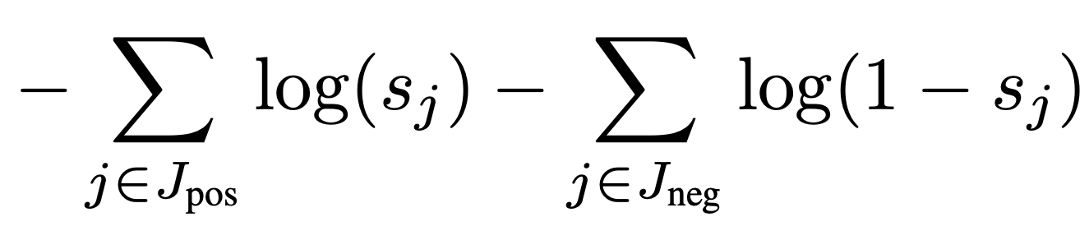
Fine-tuning a Cross-encoder for retrieval
relevance score
Loss =
d₁
Query + Positive Doc
Query + Negative Docs
d₂
BM25 /
Sparse /
Dense /
Reranker
Query
d₃
Randomly select one doc as a negative
d₄
d₅

Slide 25
Choosing a reranker
Open-source:
monoT5-3B – State-of-the-art
miniLM – one of the best given its size
mMiniLM-L6-v2-mmarco-v2 – one of the best multilingual given its size
Proprietary:
Cohere-rerank-english-v2.0

Slide 26
Differences between bi-encoders and cross-encoders
Bi-Encoders
Query is computed post-hoc, thus no influence on the embeddings.
Lower utility!
Embeddings can be produced offline and reused.
Faster retrieval!
Cross-Encoders
Query and documents are encoded jointly.
Higher utility!
Embeddings must be created at retrieval time with one encoder pass per document pair.
Slower retrieval!

Slide 27
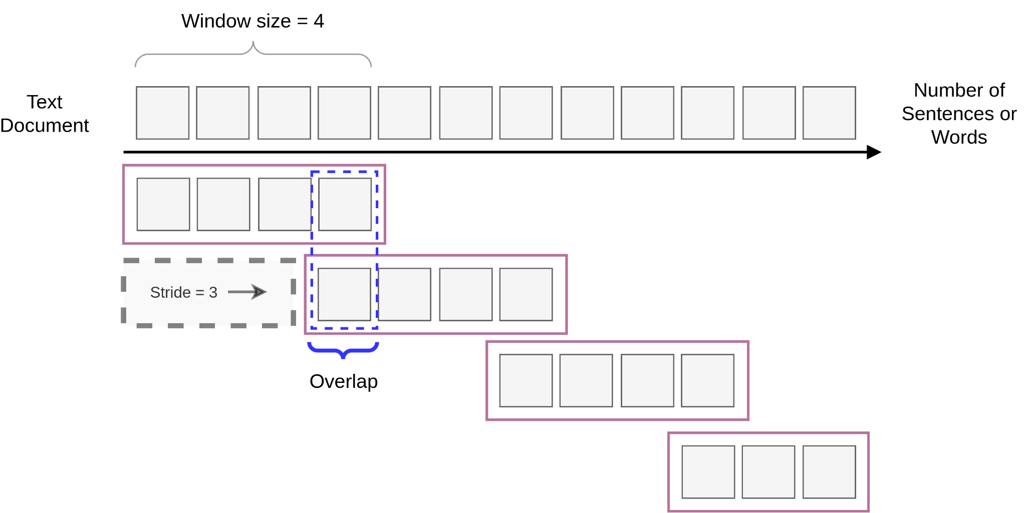
Dealing with long documents (>512 tokens)
Encoder
E_{i}
It is difficult to compress a long document into a single vector

Slide 28
Dealing with long documents – Sliding Window
Encoder
E_{i,w=1}
Encoder
E_{i,w=2}
Encoder
E_{i,w=3}
Encoder
E_{i,w=4}
Smaller strides -> more windows: decreases the chance of separating important information into 2 windows at the expense of having more windows to process.

Slide 29
Final Assignment
RAG Agent with LangChain and Mistral
Due Sunday June 16, 2024
Required to complete the course!

Slide 30
Optional Reading
LLMs with tools:
WebGPT: Browser-assisted question-answering with human feedback
The first method to propose the use of LLM + Search Engine
DSP: Demonstrate-Search-Predict
A framework for LLMs and retrievers
Toolformer: Language Models Can Teach Themselves to Use Tools
A framework proposal for using LLM's and API calls
ReAct: Synergizing Reasoning and Acting in Language Models
Another framework for using LLM's and API calls

Slide 31
End of Module 3
Questions?

